Slide 1
Using optimization to better understand leaf-to-whole plant acclimation
Nick Smith
Texas Tech University
nick.smith@ttu.edu; @nick_greg_smith
Lizz Waring (Northeastern State U)
Helen Scott (TTU)
Trevor Keenan (UC-Berkeley)

Slide 2
Plants acclimate to environmental conditions
nick.smith@ttu.edu; @nick_greg_smith
Level of operation
Population
Adaptation
Plant
Acclimation
Leaf
Instantaneous response
Cell
Seconds
Minutes
Days
Years
Decades
Centuries
Response time
Smith and Dukes (2013)

Slide 3
Plants acclimate to environmental conditions
nick.smith@ttu.edu; @nick_greg_smith
Physiological parameter
Environmental condition

Slide 4
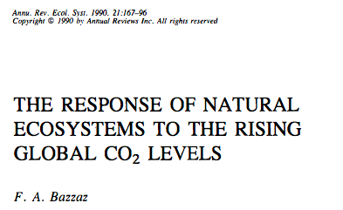
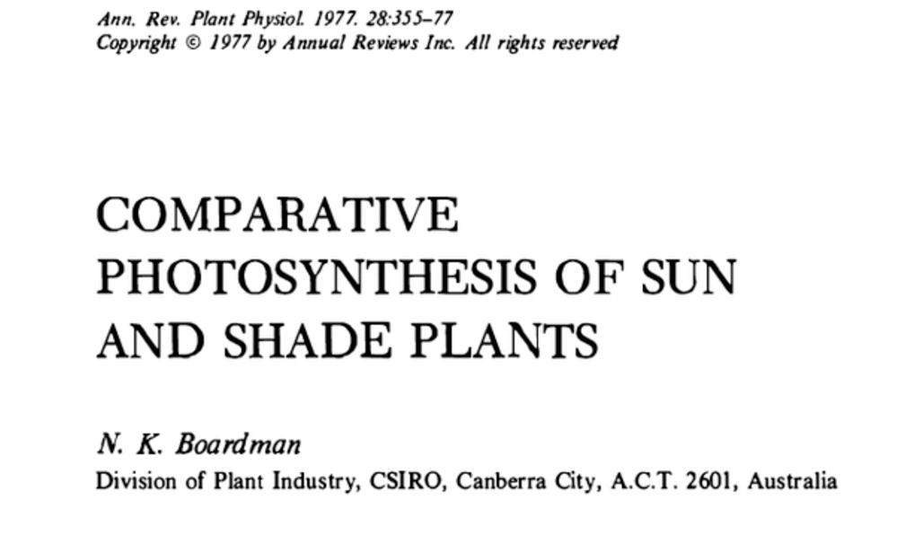
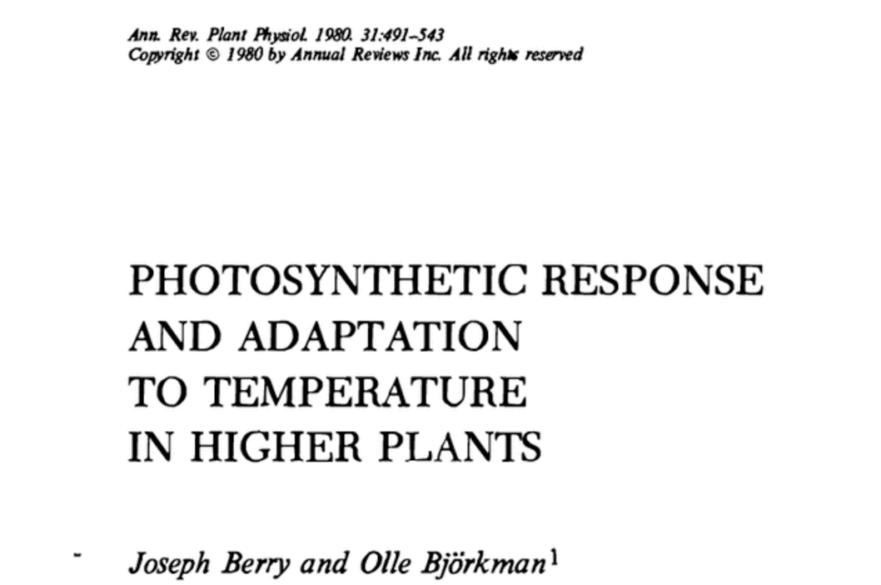
Acclimation is ubiquitous and well known…
nick.smith@ttu.edu; @nick_greg_smith
Temperature: Berry & Björkman (1980)
CO₂: Bazzaz (1990)
Light: Boardman (1977)

Slide 5
…and can impact carbon cycling and climate…
nick.smith@ttu.edu; @nick_greg_smith
Acclimation alters future temperature by >1°C
Smith et al. (2017) JAMES

Slide 6
…but the mechanisms underlying photosynthetic acclimation are not well known
nick.smith@ttu.edu; @nick_greg_smith

Slide 7
Solution: A testable, theoretical model!
nick.smith@ttu.edu; @nick_greg_smith

Slide 8
Least cost theory
nick.smith@ttu.edu; @nick_greg_smith
Maintain fastest rate of photosynthesis at the lowest cost (water and nutrient use)
Wright et al. (2003) American Naturalist

Slide 9
Least cost theory
nick.smith@ttu.edu; @nick_greg_smith
[TALK TO ME LATER ABOUT THE MATHS]
Wright et al. (2003). American Naturalist
Prentice et al. (2014). Ecology Letters
Wang et al. (2017). Nature Plants
Smith et al. (2019). Ecology Letters
Stocker et al. (2019). Geoscientific Model Development Discussion

Slide 10
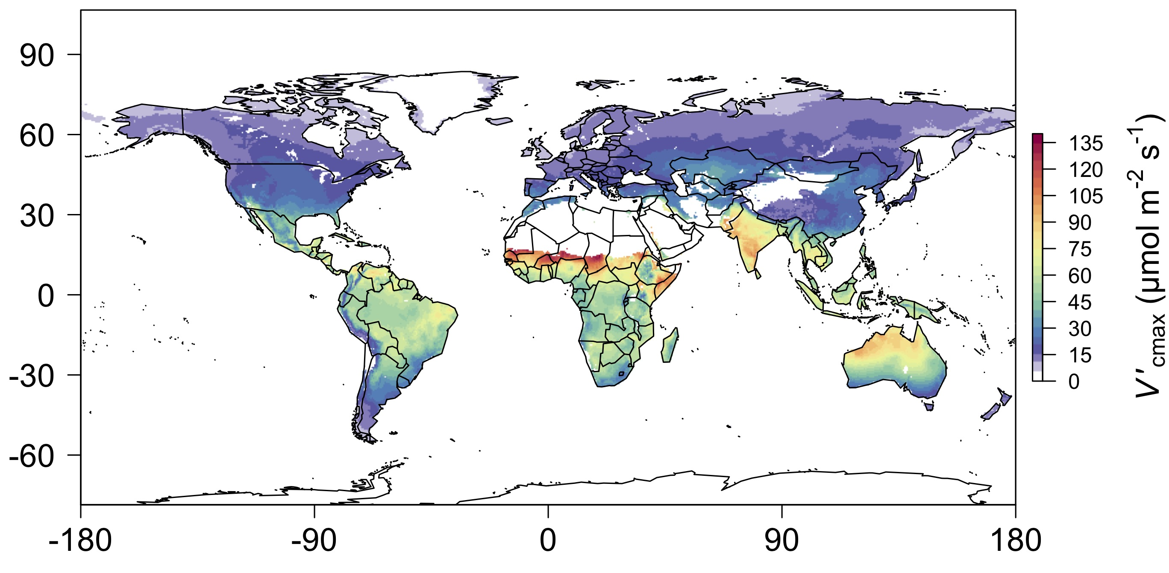
nick.smith@ttu.edu; @nick_greg_smith
We can predict optimal traits in different environments
Smith et al. (2019) Ecology Letters

Slide 11
We can use the theory as a null model to explore acclimation mechanisms
nick.smith@ttu.edu; @nick_greg_smith

Slide 12
Let’s tackle some big questions in plant ecophysiology!
nick.smith@ttu.edu; @nick_greg_smith

Slide 13
Question 1: Is photosynthesis optimized to the environment?
nick.smith@ttu.edu; @nick_greg_smith

Slide 14
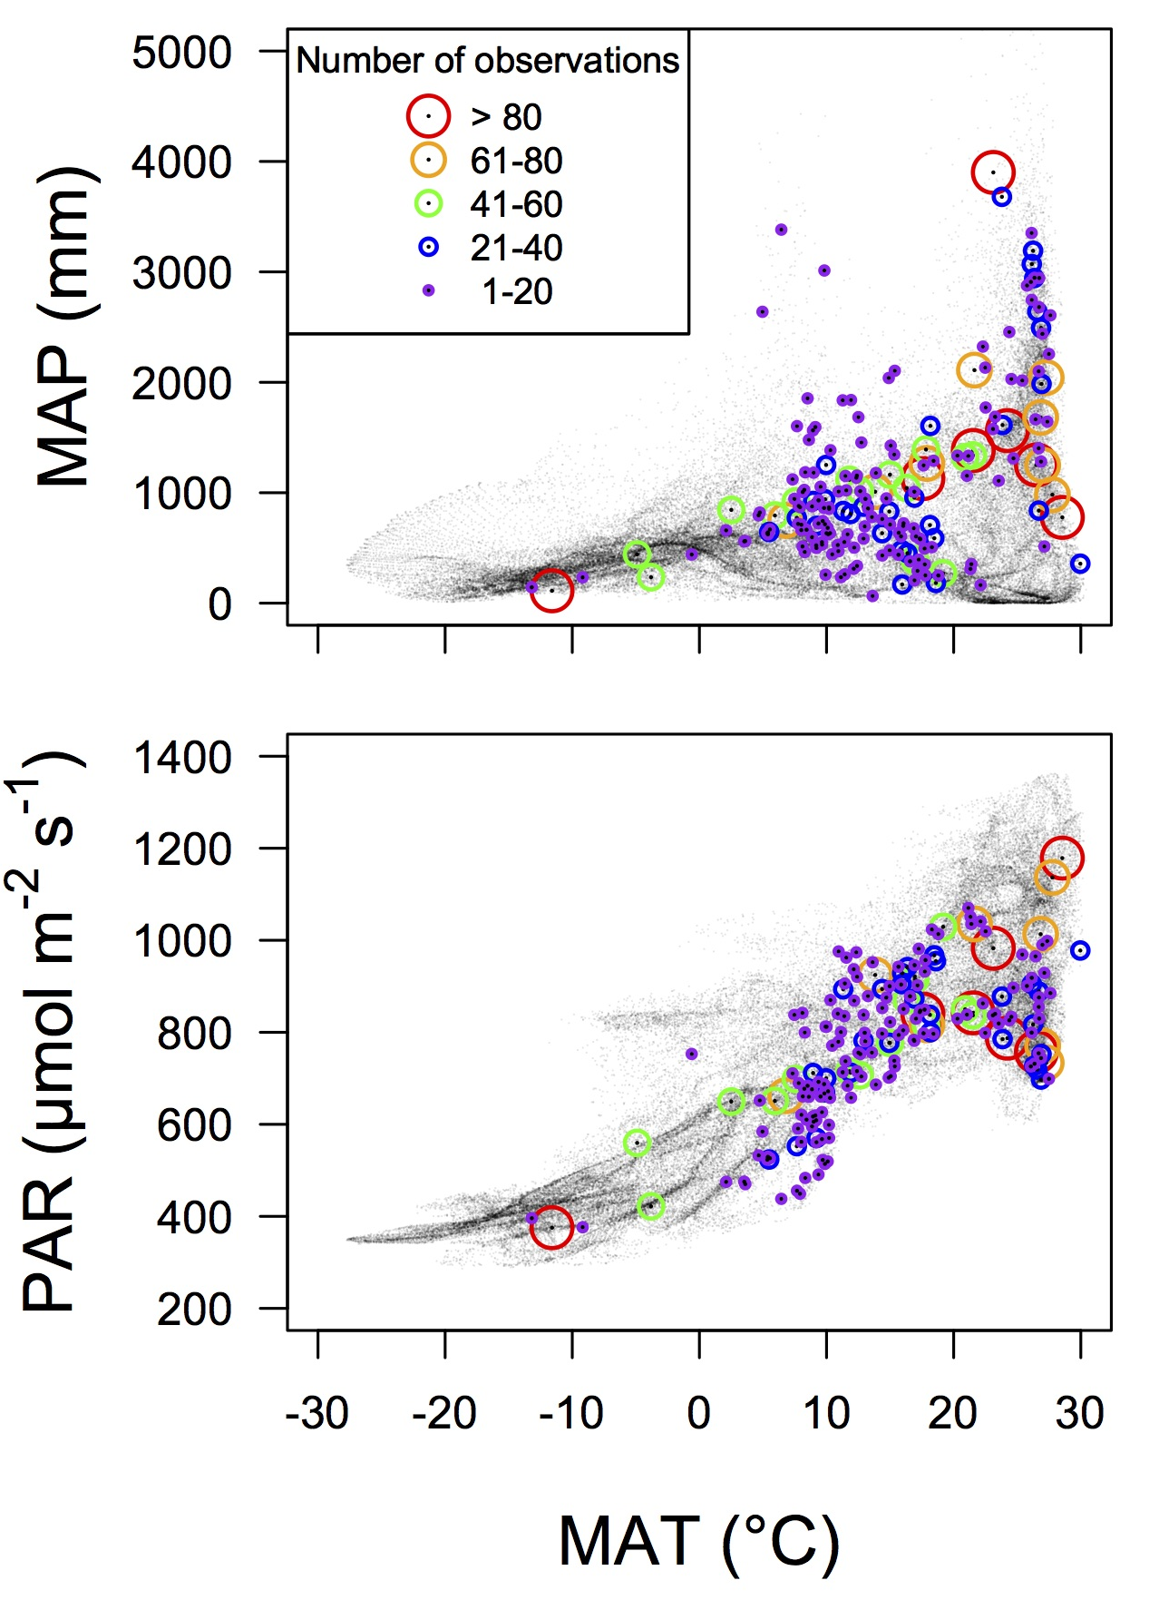
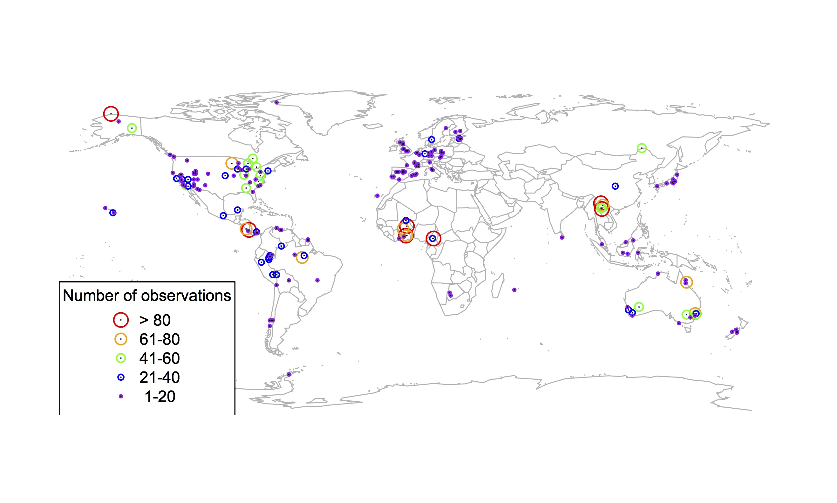
Global V_{cmax} dataset
nick.smith@ttu.edu; @nick_greg_smith
3,697 measurements
202 sites
> 600 genera
Smith et al. (2019) Ecology Letters

Slide 15

nick.smith@ttu.edu; @nick_greg_smith
Smith et al. (2019) Ecology Letters

Slide 16
Question 1: Is photosynthesis optimized to the environment? YES! Photosynthesis acclimates spatially as expected from optimization
nick.smith@ttu.edu; @nick_greg_smith

Slide 17

Question 2: Does photosynthesis respond to soil nutrients?
nick.smith@ttu.edu; @nick_greg_smith
Lizz Waring
TTU

Slide 18
From the least cost hypothesis…
nick.smith@ttu.edu; @nick_greg_smith
Added nutrients will not increase photosynthesis because light limitation will kick in

Slide 19
From the least cost hypothesis…
nick.smith@ttu.edu; @nick_greg_smith
Added nutrients will not increase photosynthesis because light limitation will kick in
Optimal response might be to increase leaf area to access more light

Slide 20
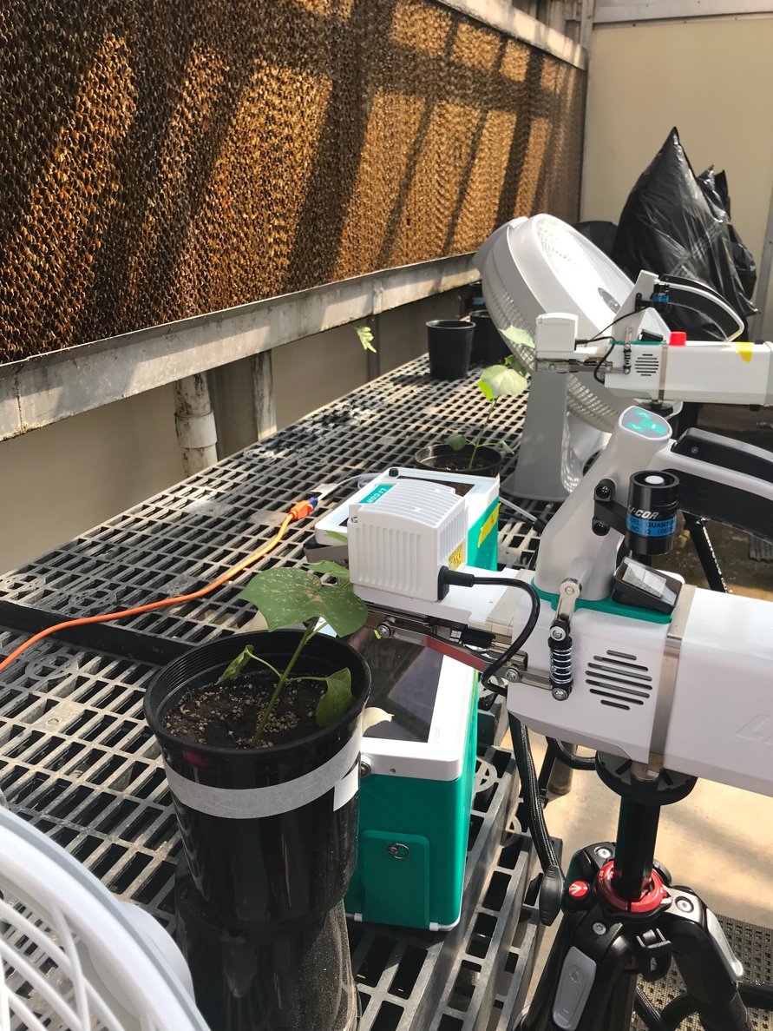
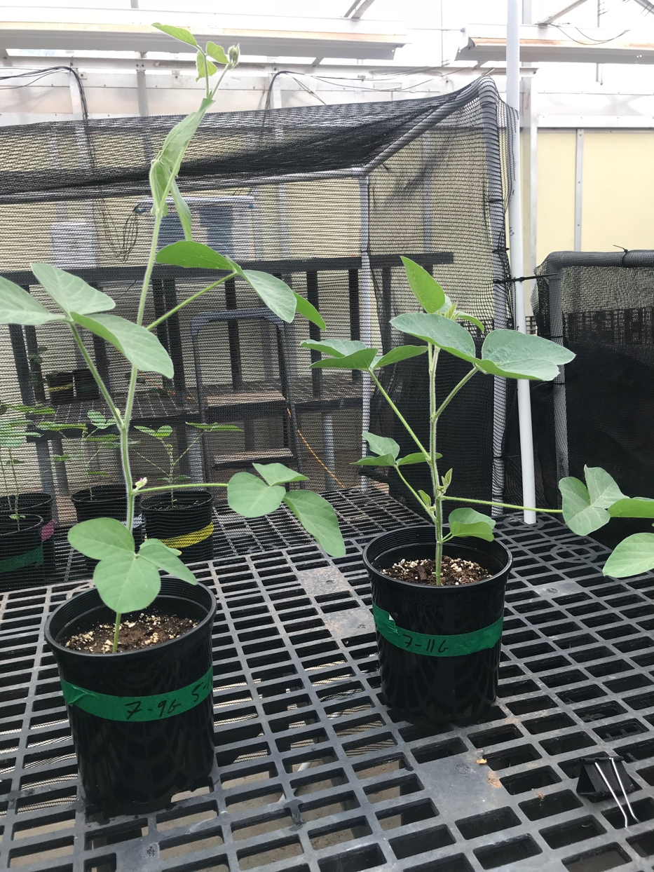
But let’s test it experimentally
nick.smith@ttu.edu; @nick_greg_smith

Slide 21
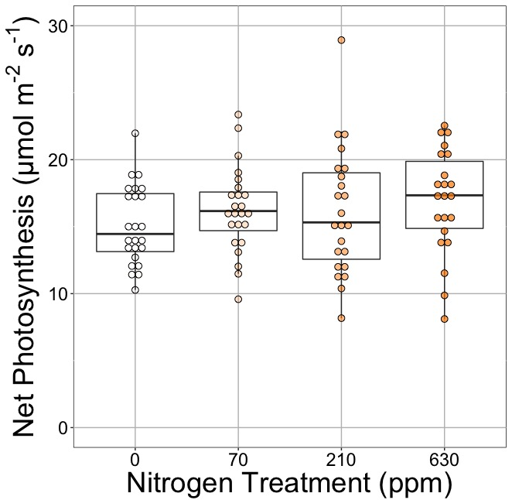
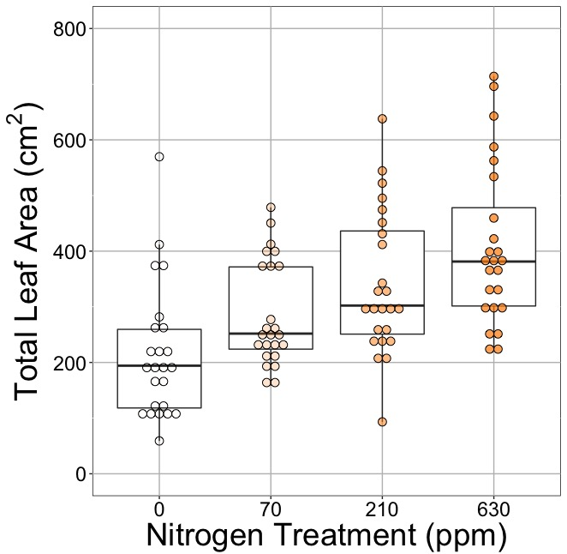
nick.smith@ttu.edu; @nick_greg_smith
Waring and Smith (in prep)

Slide 22
nick.smith@ttu.edu; @nick_greg_smith
No change (P = 0.42)
Waring and Smith (in prep)

Slide 23
Leaf area, but not photosynthesis increases with N addition
nick.smith@ttu.edu; @nick_greg_smith
No change (P = 0.42)
91% increase (P < 0.05)
Waring and Smith (in prep)

Slide 24
But do greenhouse experiments translate to the field?
nick.smith@ttu.edu; @nick_greg_smith

Slide 25
nick.smith@ttu.edu; @nick_greg_smith
Grassland soil nutrient addition network:
Leaf area index
Per-leaf-area nitrogen (photosynthetic proxy)

Slide 26
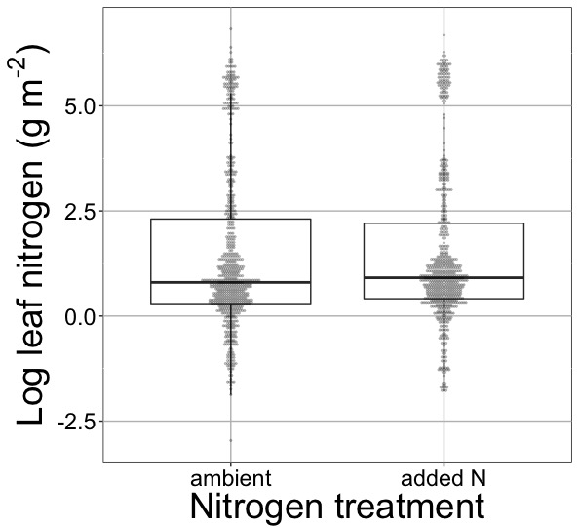
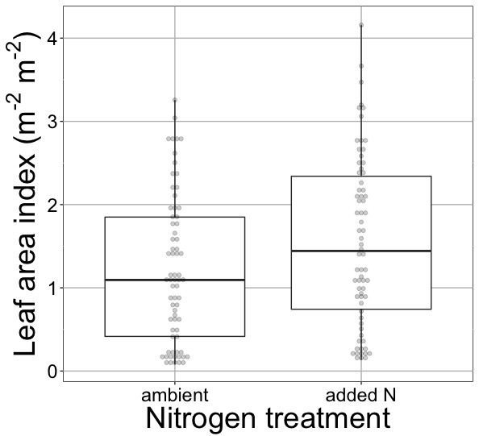
nick.smith@ttu.edu; @nick_greg_smith
Waring and Smith (in prep)

Slide 27
nick.smith@ttu.edu; @nick_greg_smith
No change (P > 0.05)
Waring and Smith (in prep)

Slide 28
Globally, N addition increases leaf area, not leaf N
nick.smith@ttu.edu; @nick_greg_smith
No change (P > 0.05)
41% increase (P < 0.05)
Waring and Smith (in prep)

Slide 29
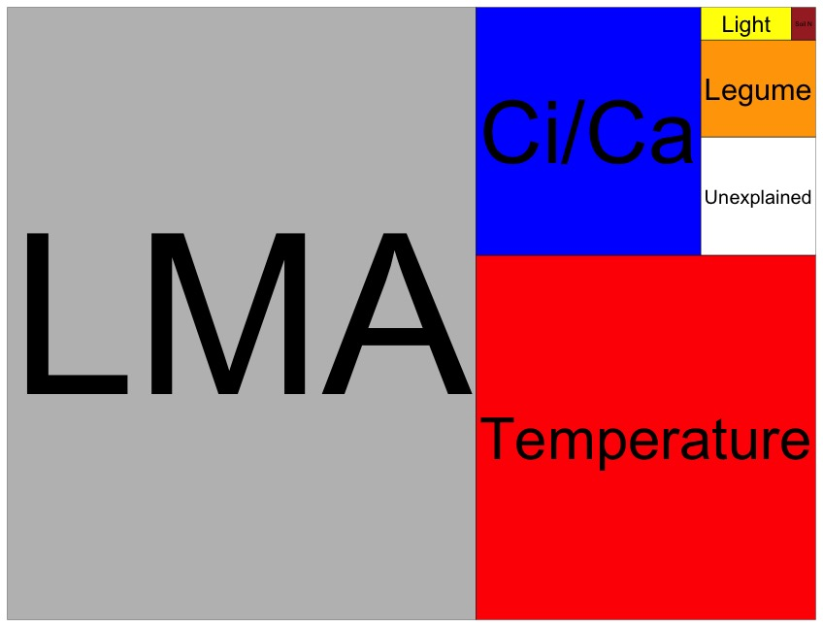
Globally, N addition has no impact on leaf N
nick.smith@ttu.edu; @nick_greg_smith
Each box is proportional to the variance in leaf N explained by each variable
Waring and Smith (in prep)

Slide 30
Question 2: Does photosynthesis respond to soil nutrients? No, plants respond to added nutrients by increasing leaf area, not photosynthesis
nick.smith@ttu.edu; @nick_greg_smith

Slide 31

Question 3: What does acclimation mean for future conditions?
nick.smith@ttu.edu; @nick_greg_smith

Slide 32
Photosynthetic traits change with future conditions in ways expected from optimization
nick.smith@ttu.edu; @nick_greg_smith
mean: -12%
mean: -15%
(P > 0.05)
Smith and Keenan (in prep)

Slide 33
Let’s run a model out into the future!
nick.smith@ttu.edu; @nick_greg_smith

Slide 34
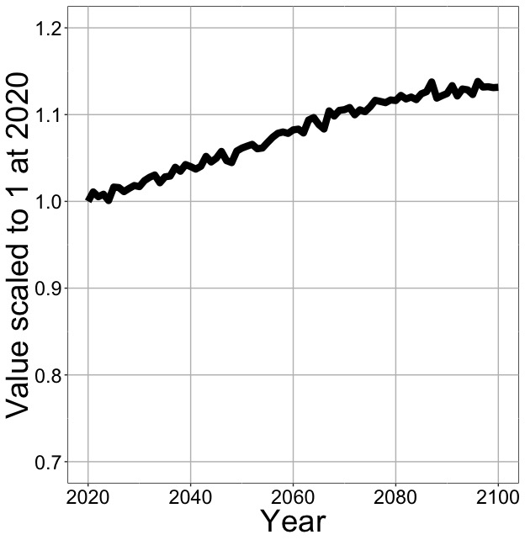
Photosynthesis increases in future
nick.smith@ttu.edu; @nick_greg_smith
Net Photosynthesis
Smith et al. (in prep)

Slide 35
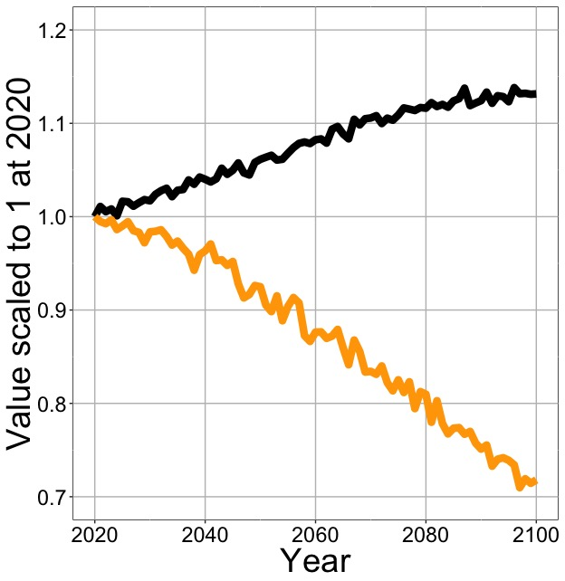
Photosynthesis increases in future (at lower nutrient use)
nick.smith@ttu.edu; @nick_greg_smith
Net Photosynthesis
Leaf Nitrogen
Smith et al. (in prep)

Slide 36
Need to rethink nutrient limitation in models
“No limitation” simulation
“Nutrient limitation” simulations
Weider et al. (2015)

Slide 37
Question 3: What does acclimation mean for future conditions? Photosynthesis will increase and per-leaf-area nutrient use will decrease
nick.smith@ttu.edu; @nick_greg_smith

Slide 38
Conclusions
nick.smith@ttu.edu; @nick_greg_smith

Slide 39
Conclusions
nick.smith@ttu.edu; @nick_greg_smith
Plants aren’t dumb!
Need to make sure our models allow for acclimation responses
Dumb plants

Slide 40
Conclusions
nick.smith@ttu.edu; @nick_greg_smith
Theory yields mechanistic insight about acclimation and associated feedbacks

Slide 41
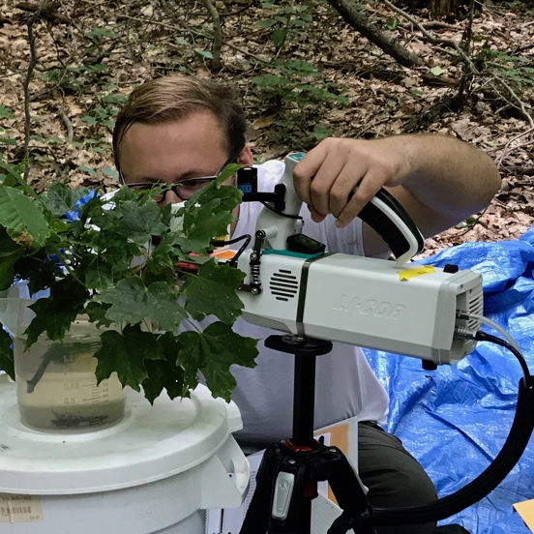
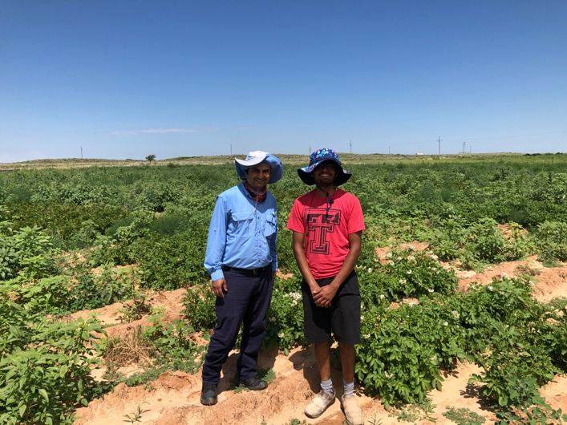
Conclusions
nick.smith@ttu.edu; @nick_greg_smith
Theory yields mechanistic insight about acclimation and associated feedbacks
We using it to study
C3/C4 competition
Plant invasion
Mycorrhizal symbioses
Agriculture
Herbarium specimens

Slide 42
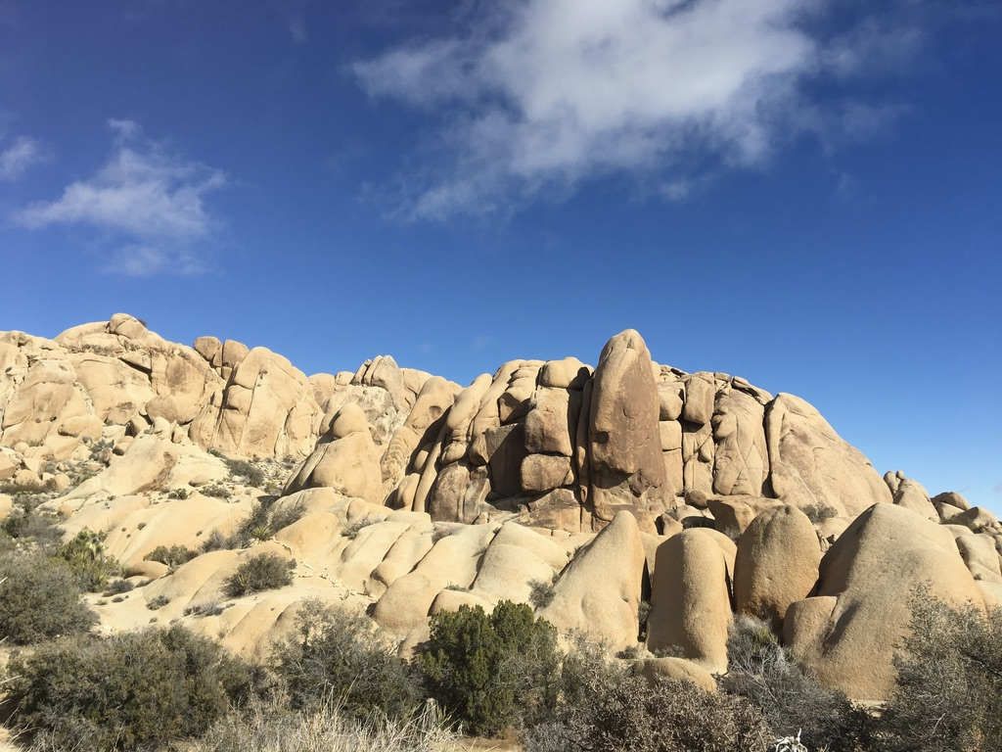
nick.smith@ttu.edu; @nick_greg_smith
Presentation available at:
www.github.com/SmithEcophysLab/agu_2019
Thanks!

